Slide 1
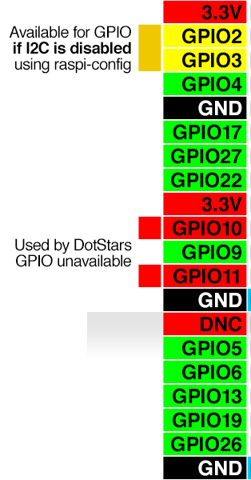
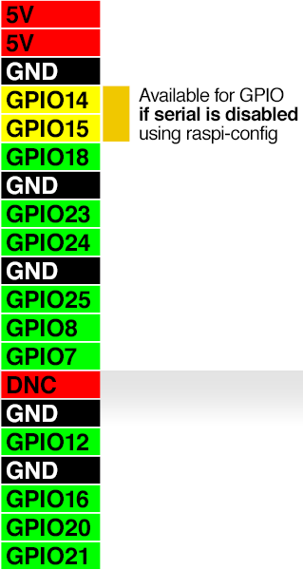
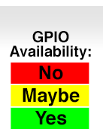
1
3
5
7
9
11
13
15
17
19
21
23
25
2
4
6
8
10
12
14
16
18
20
22
24
26
I2C
SDA (Serial Data line)
SCL (Serial Clock Line)
UART
TXD (Transmit)
RXD (Receive)
LED
MOSI (Master Out-Slave In)
MOSI (Master In Slave Out)
SCLK (System clock)
SPI0_CE0_Negative
SPI0_CE1_Negative
2729
31
33
35
37
39
2830
32
34
36
38
40

Slide 2
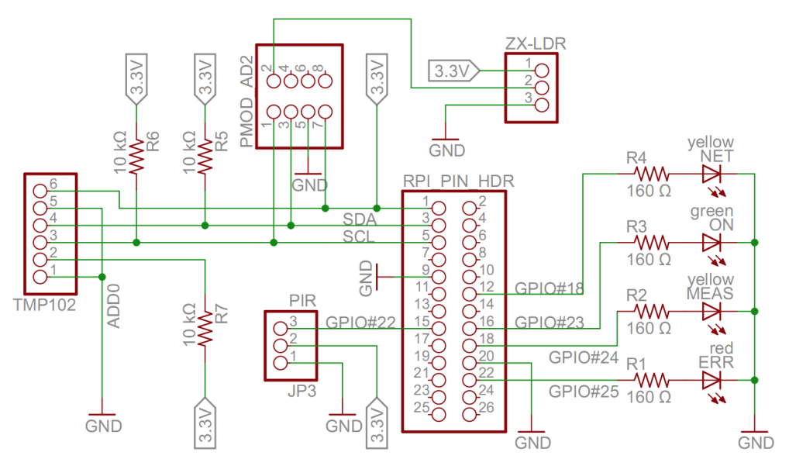
Pi pin usage schematic
Appendix B of https://www.packtpub.com/sites/default/files/downloads/3494_3532OT_Appendices.pdf
Notes:
iot rpi clayster circuits.png .png

Slide 3
ssh
~() > ssh pi@10.0.0.6
pi@10.0.0.6's password:
The programs included with the Debian GNU/Linux system are free software;
the exact distribution terms for each program are described in the
individual files in /usr/share/doc/*/copyright.
Debian GNU/Linux comes with ABSOLUTELY NO WARRANTY, to the extent
permitted by applicable law.
Last login: Mon Nov 28 09:17:26 2016
pi@raspberrypi:~ $ sudo raspi-config

Slide 4
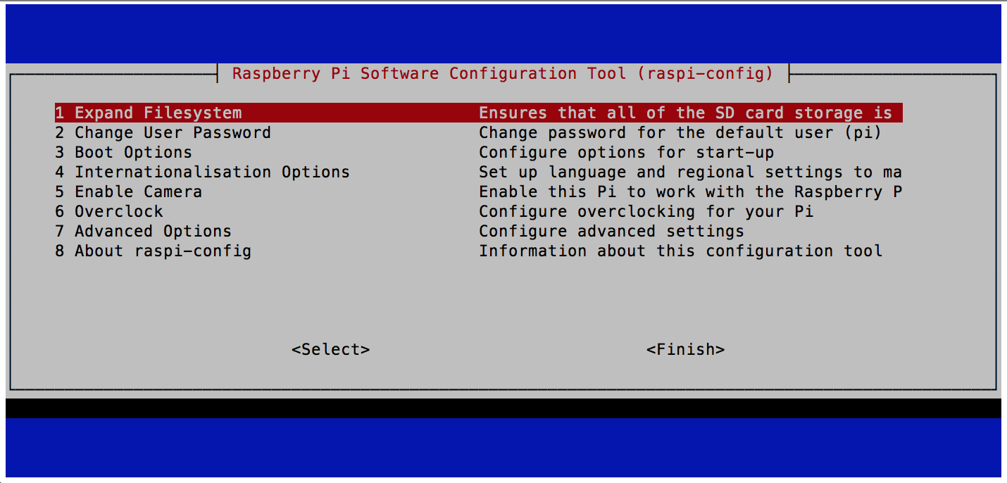
raspi-config
Use keyboard up/down cursor keys, then Enter key to select.
https://www.raspberrypi.org/documentation/configuration/raspi-config.md

Slide 5
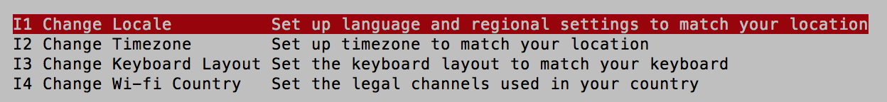
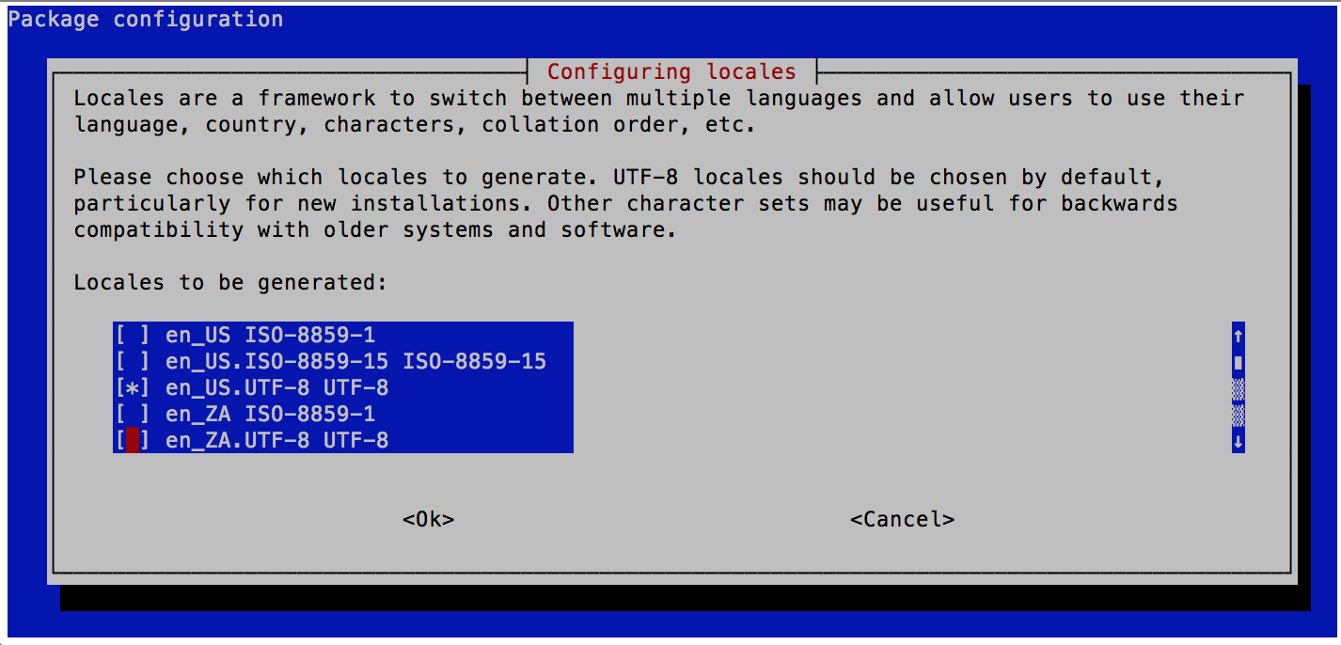
raspi-config Locale
en_GB.UTF-8 UTF-8
Use keyboard up/down cursor keys, then Tab key to <Ok>.
https://www.raspberrypi.org/documentation/configuration/raspi-config.md

Slide 6
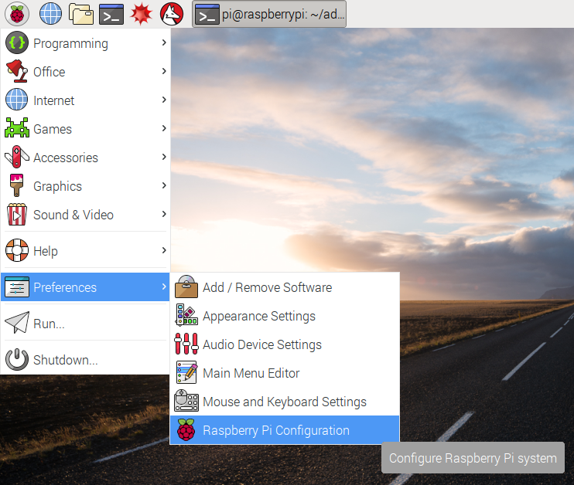
Jessie Pi Preferences Configuration
https://www.raspberrypi.org/learning/getting-started-with-picamera/images/raspi-config-menu.png

Slide 7
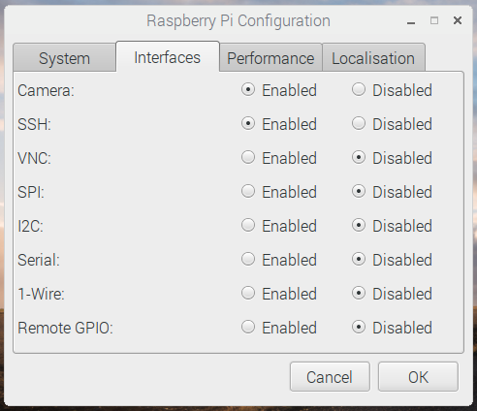
Jessie Pi Preferences Configuration Camera
https://www.raspberrypi.org/learning/getting-started-with-picamera/images/raspi-config-menu.png

Slide 8
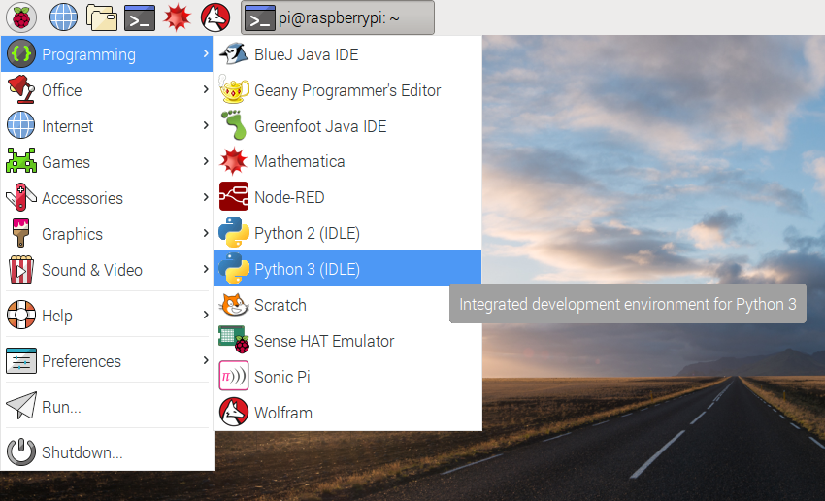
Jessie Pi Python IDLE
https://www.raspberrypi.org/learning/getting-started-with-picamera/images/raspi-config-menu.png

